Slide 1
Mobile Application Development Introduction to Android Platform Architecture
Muhammad Ibtisam Gul

Slide 2
Topics
The Android Platform Architecture
Linux Kernel
Hardware Abstraction Layer (HAL)
Libraries
Android Runtime
Java API Framework
Applications
Typical Workflow of Android App

Slide 3
The Android Platform
Android is an open source, Linux-based software stack created for a wide array of devices and form factors.
Android SDK for creating apps Libraries & development tools
Lots of documentation.
Start browsing today!
See: http://developer.android.com/training

Slide 4
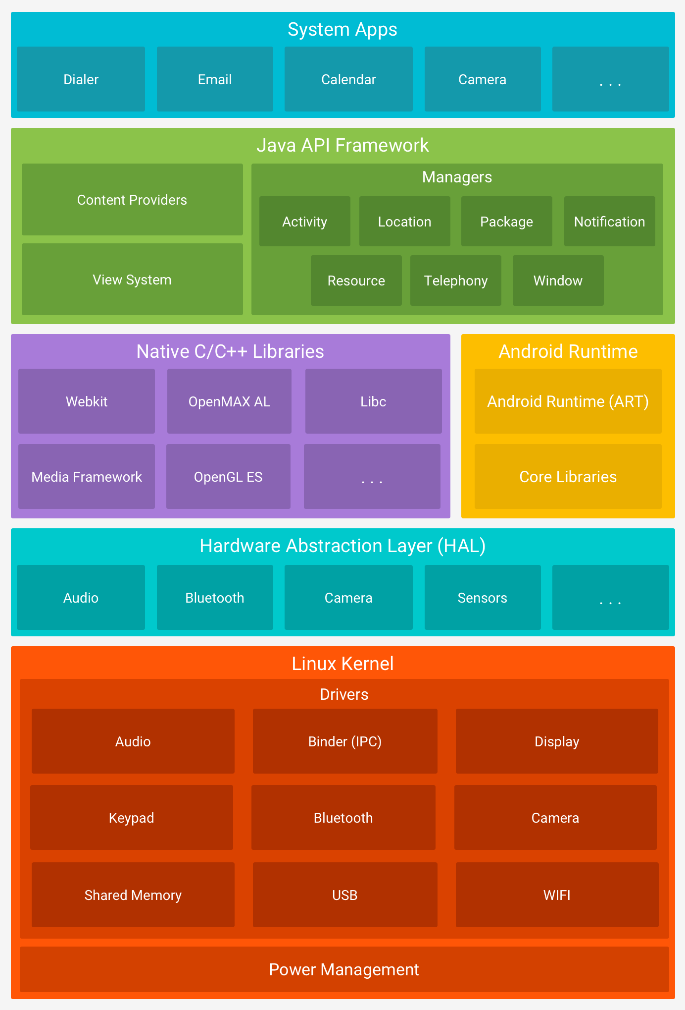
The Android Platform Architecture

Slide 5
Linux Kernel – Standard Services
Security
Permissions Architecture
Memory & process management
Multiple processes can run simultaneously
File & network I/O
Handles low level details
Device drivers
Notes:
The kernel is a computer program that is the core of a computer's operating system, with complete control over everything in the system.^{[1]} On most systems, it is one of the first programs loaded on start-up (after the bootloader). It handles the rest of start-up as well as input/output requests from software, translating them into data-processing instructions for the central processing unit. It handles memory and peripherals like keyboards, monitors, printers, and speakers.

Slide 6
Linux Kernel – Specific Services
Power management
Android shared memory
Low memory killer
Inter-process communication (Binder)
Facilitate data and service sharing between multiple processes.
And much more

Slide 7
The Android Platform Architecture

Slide 8
Hardware Abstraction Layer (HAL)
It provides standard interfaces that expose device hardware capabilities to the higher-level Java API framework.
The HAL consists of multiple library modules, each of which implements an interface for a specific type of hardware component, such as the camera or Bluetooth module.
When a framework API makes a call to access device hardware, the Android system loads the library module for that hardware component.

Slide 9
The Android Platform Architecture

Slide 10
Android Runtime
Two main components:
Core Java libraries
Virtual Machine (runtime)
Major features of ART:
Ahead of Time (AOT) and Just in Time (JIT) compilation
Optimized garbage collection
Better debugging

Slide 11
Core Java Libraries
Android also includes a set of core runtime libraries that provide most of the functionality of the Java programming language, including some Java 8 language features, that the Java API framework uses.

Slide 12
The Android Platform Architecture

Slide 13
Libraries (Native Libraries)
Many core Android system components and services, such as ART and HAL, are built from native code that require native libraries written in C and C++.
The Android platform provides Java framework APIs to expose the functionality of some of these native libraries to apps.
If you are developing an app that requires C or C++ code, you can use the Android NDK to access some of these native platform libraries directly from your native code.

Slide 14
The Android Platform Architecture

Slide 15
Java API Framework
The entire feature-set of the Android OS is available to you through APIs written in the Java language.
These APIs form the building blocks you need to create Android apps by simplifying the reuse of core, modular system components and services, which include the following:
View System
Resource Manager
Notification Manager
Activity Manager
Content Providers

Slide 16
View System
Provides common user interface elements
e.g., icons, text entry boxes, buttons and more
A View occupies a rectangular area on the screen
Responsible for drawing and event handling

Slide 17
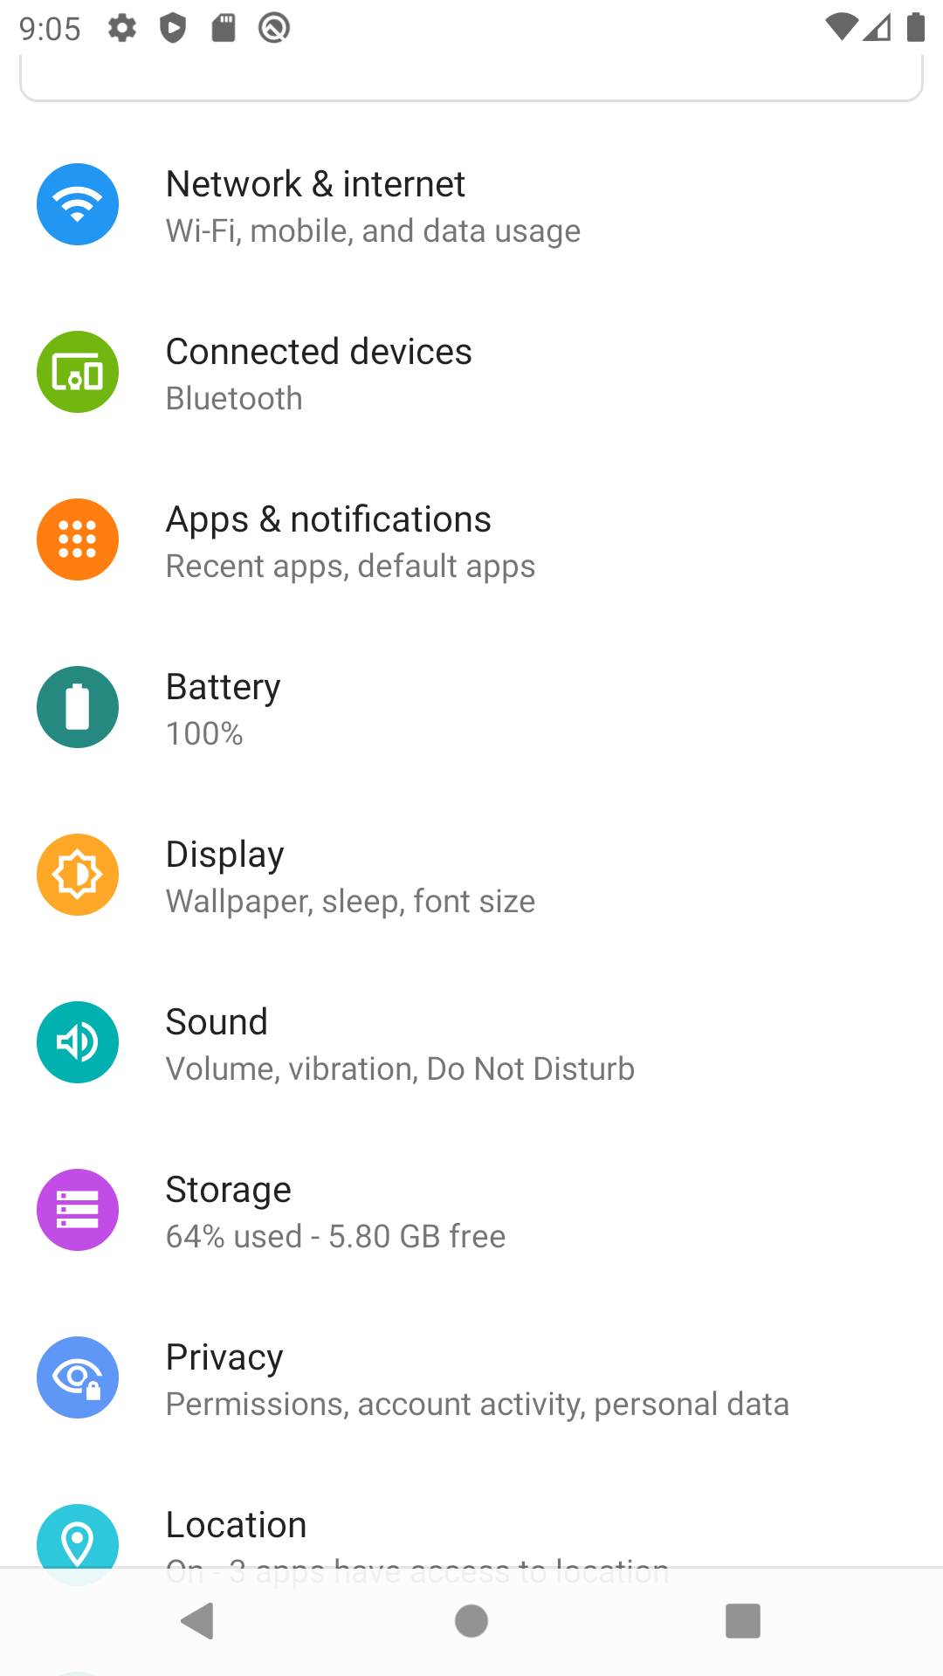
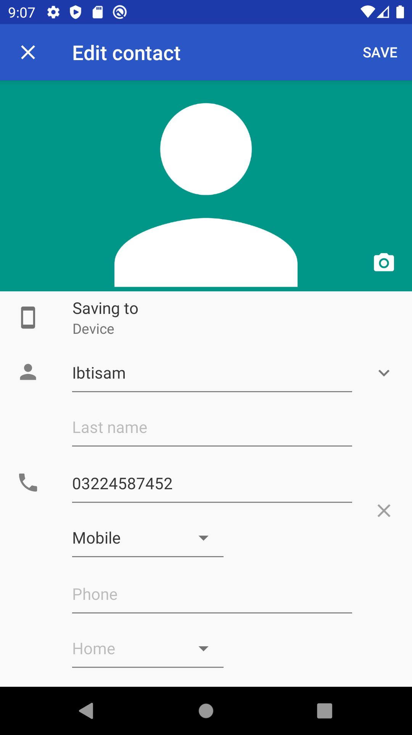

Slide 18
Content Provider
Manages access to a central repository of data
Handles inter-process communication
Handles secure data access.
Enable apps to access data from other apps
E.g. Phone app accessing contacts app for contact info
Apps can use it to share their own data

Slide 19
Package Manager
Keeps track of app packages on device
Usually a database that keeps tracks of all the apps installed on your device
It allows apps to find each other
E.g. for data sharing

Slide 20
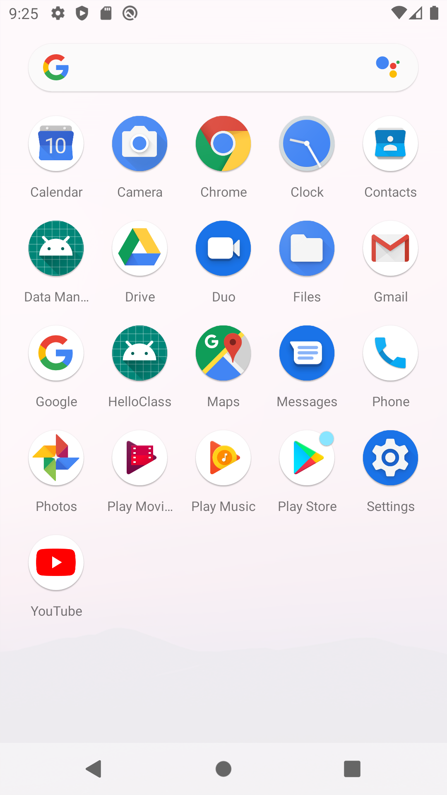

Slide 21
Window Manager
The Android WindowManager is a system service
Responsible for managing the list of windows
Which windows are visible, and how they are laid out on screen.
It automatically performs window transitions and animations when opening or closing an app or rotating the screen.

Slide 22
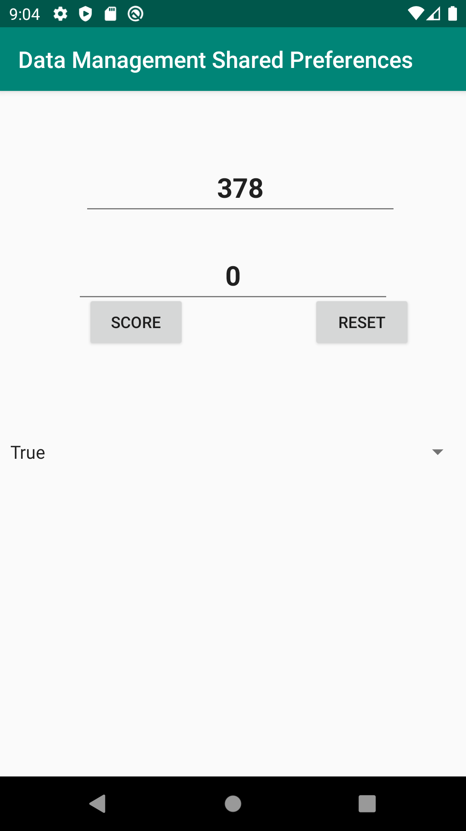
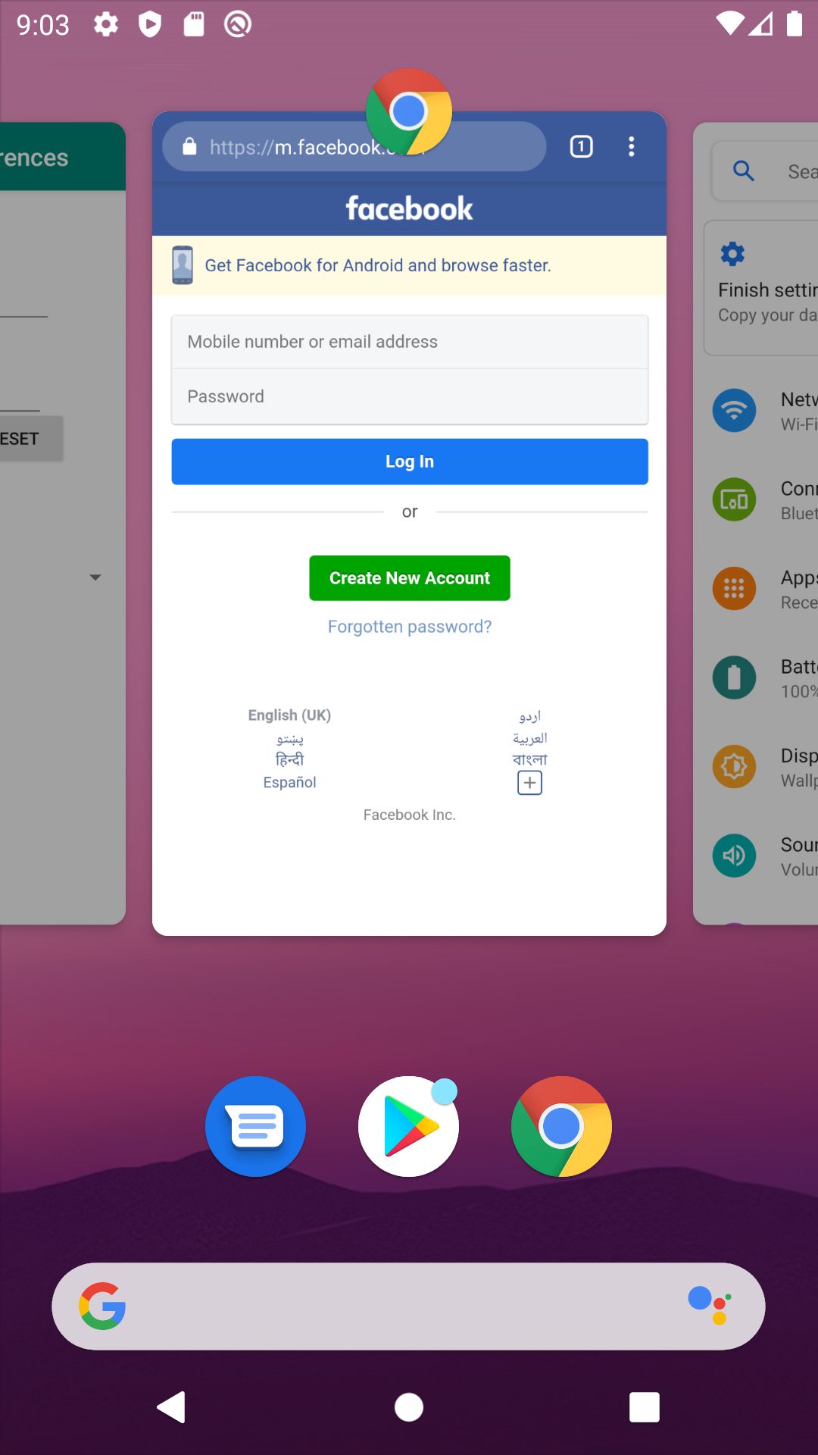

Slide 23
Resource Manager
Manages non-compiled resources that make up an app
e.g., strings, graphics, & layout files
For example
you might want to provide a different UI layout depending on the screen size or different strings depending on the language setting.

Slide 24
Activity Manager
Manages app lifecycle
Provides information about, and interacts with, activities, services, and the containing process
Provides navigation back-stack

Slide 25
Location Manager
Provides geographical location & movement information
GPS or Network provider location

Slide 26
Notification Manager
Notify the user of events that happen.
Notifications can take different forms:
A persistent icon that goes in the status bar and is accessible through the launcher
Turning on or flashing LEDs on the device
Alerting the user by flashing the backlight, playing a sound, or vibrating.

Slide 27
Applications
Standard apps include:
Home – main screen
Contacts – contacts database
Phone – dial phone numbers
Browser – view web pages
Email reader –compose & read email messages
Nothing special about these apps You can substitute your own or 3rd party app for any of them

Slide 28
Typical workflow of Android App
Code written in java
Compiled to Java bytecode files
Converted to DEX bytecode file from multiple java bytecode files by d8 (DX Converter)
Executed by ART (DEX bytecode file)

Slide 29
References
https://developer.android.com/guide/platform

